Slide 1
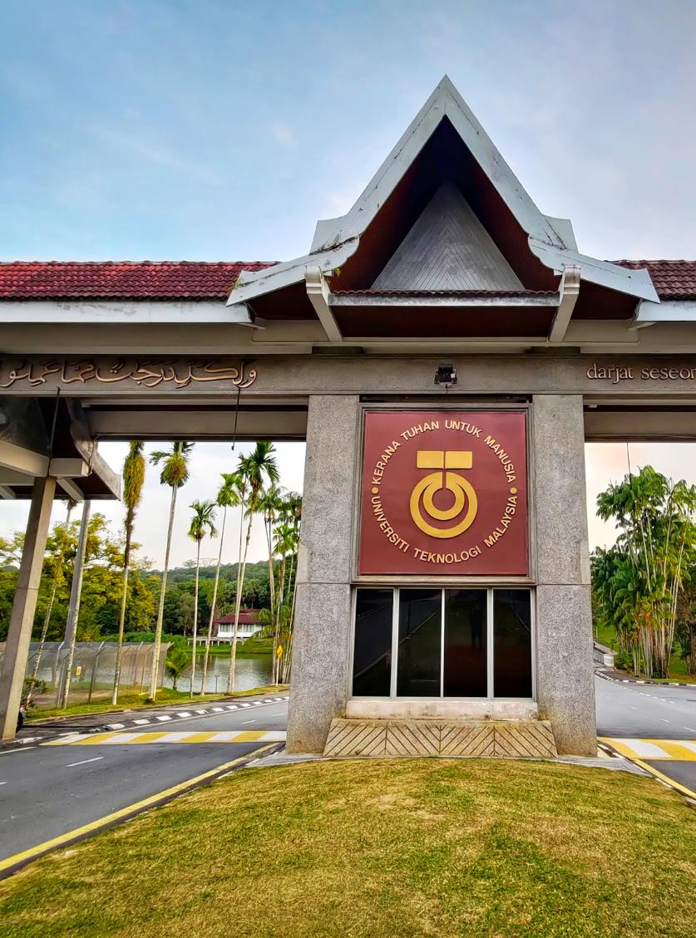
Chapter 1: Emerging Technology in Information Communication Technology (ICT)
UTM JOHOR BAHRU

Slide 2
Objectives
Explain the meaning of Information Technology (IT)?
Explain the history of ICT
Explain the current trend in ICT
Job in IT

Slide 3
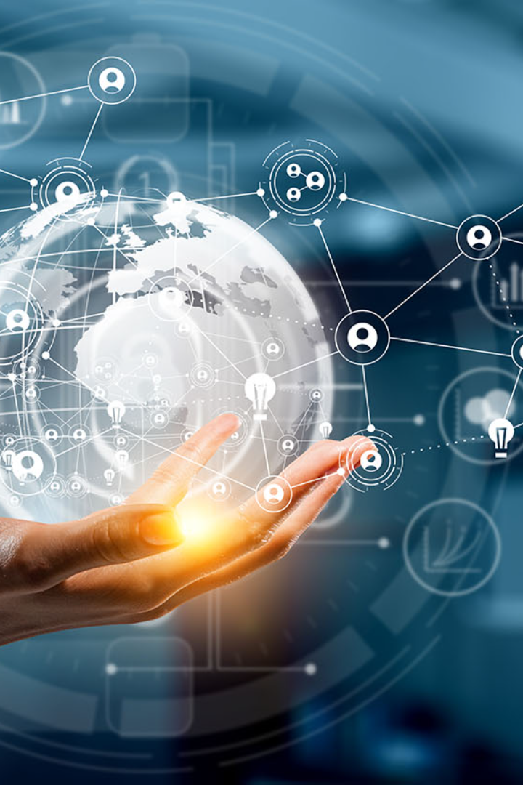
What is information Technology (IT)
Activity
Activity Introduction (15 minutes):
Discuss with your friends
Share their personal experiences with IT.
What devices do they use daily?
How do they communicate, learn, or entertain themselves using technology?
Discussing the importance of information technology in today's world.
share with your friend how technology has influenced their lives.

Slide 4
What is computer?
COMPUTER :- A computer is a programmable electronic device. It takes data through input devices. It processes the data according to a sequence of instructions provided in the form of a program. The result is called the output and given through some output device.

Slide 5
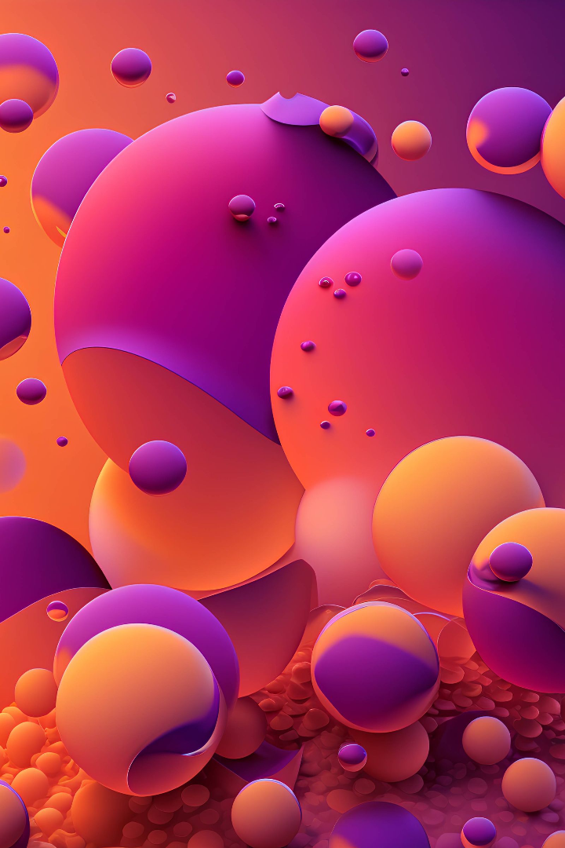
ICT Overview
Information and Communication Technology (ICT) is the backbone of modern-day technological advancements. It covers a wide range of applications, from telecommunication to computer networking. ICT relies on a combination of hardware, software, and data to deliver efficient communication.

Slide 6
History of ICT Development

Slide 7
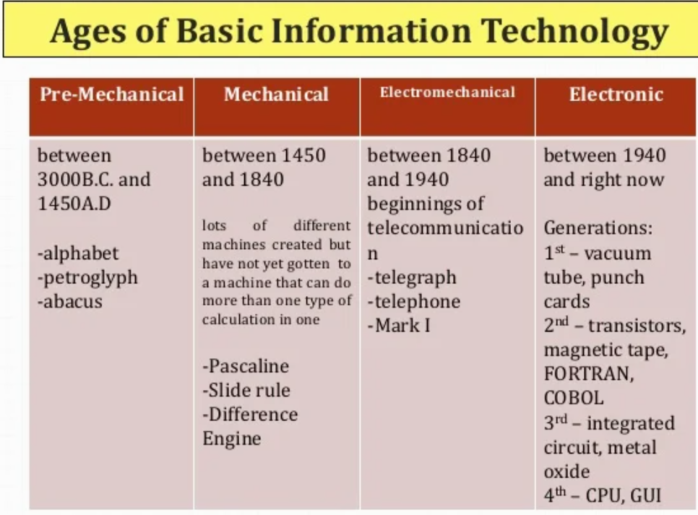

Slide 8
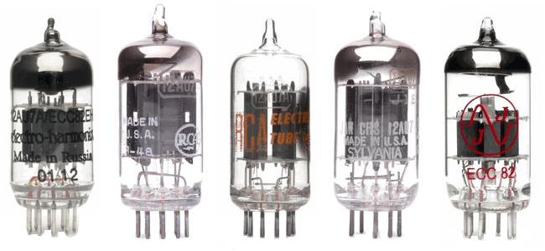
ELECTRONIC
First Generation (Vacuum Tubes)
information is sent by electric current (electron movement) whose speed is close to light velocity (300,000 km/second)
Was programmed with 6000 multiposition electric switches
programs and data were stored in separate memories, so that data entry and alteration were not a boring job

Slide 9
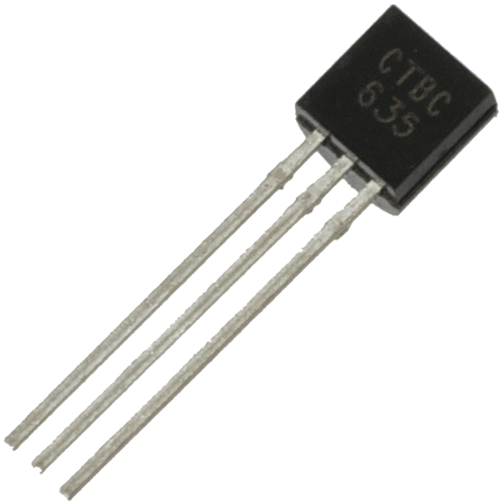
Second Generation Computer (Transistor): 1955-1965
The transistor era was marked by the innovation on hardware and some program design methodology (software technology).
It used transistor as vacum tubes substitute.
“High level” programming language did not depend on independent machine such as ALGOL, COBOL, FORTRAN.
Some of the computers were PDP, IBM, and CDC.

Slide 10
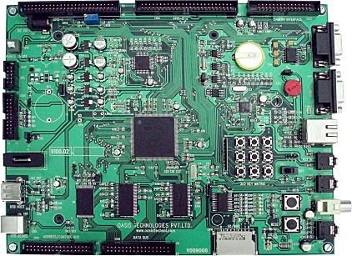
Third Generation Computer (Integrated Circuit): 1965-1980
In this era some of the development were:
IC was used as transistor substitute, so the size was smaller.
Semiconductor memory was used as main memory.
Microprogramming technique, makes CPU design simpler and more flexible.
Parallel processing was used, so counting was faster.
Operating system was used.
Some types of third generation computer from IBM (Mainframe) were:
IBM System/360 IBM System/370
IBM System/4300 IBM System/3900
Others were the series of PDP from DEC

Slide 11
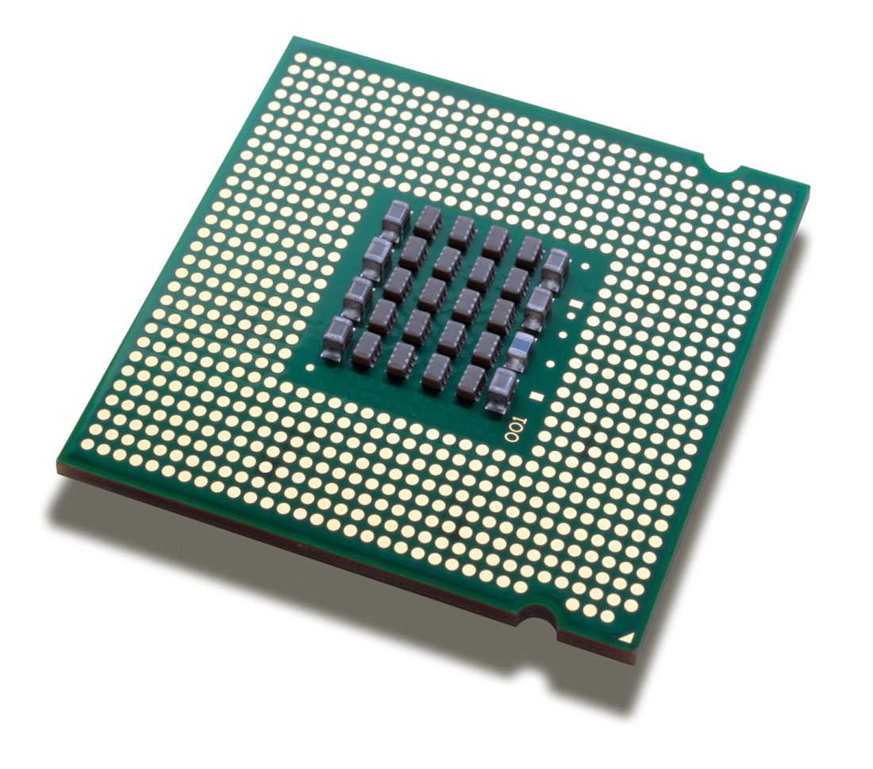
Fourth Generation Computer (VLSI): 1980 to now
In 1980, technology of VLSI (very large scale integration) has enabled the use of hundreds and finally millions of transistors in one chip or micro processor.
This technology enables the creation of CPU, memory and other components in a single chip which can be produced massively in a cheap price.
At last, it can produce smaller, faster, and cheaper computers, that everyone can afford. This technology starts the era of Personal Computer (PC).

Slide 12
Fifth Generation Computer
The term fifth generation computer is created by a Japanese to describe a “smart” computer which was built in the mid 1990s.
The development involves artificial intelligence, expert system, and natural programming language.
The focus of the fifth generation is connectivity, by connecting a computer to other computers, to form parallel computation.

Slide 13
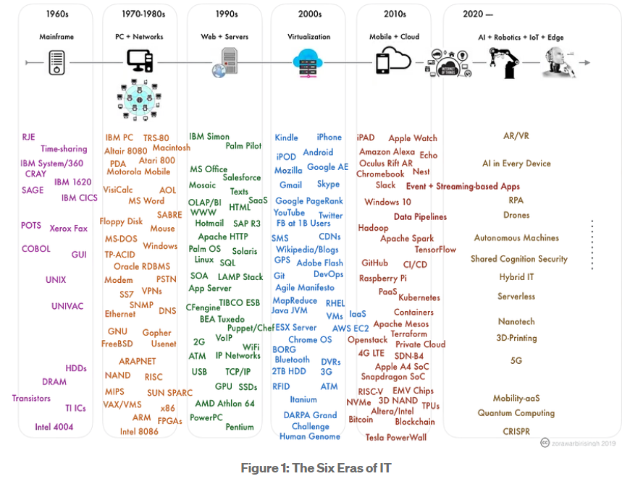
Six Eras of IT
https://medium.com/@zbirisingh/six-eras-of-it-thoughts-on-technology-and-platform-cycles-921d9b2fae77

Slide 14
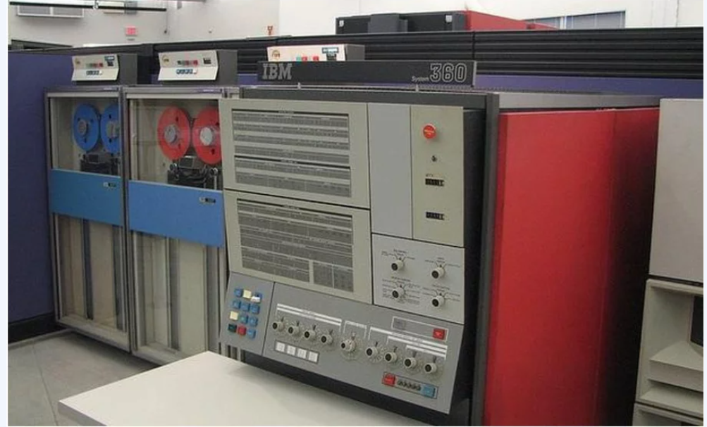
Mainframe
The introduction of the IBM 1401 and 7090 transistorized machines in 1959 marked the beginning of widespread commercial use of mainframe computers. In 1965, the mainframe computer truly came into its own with the introduction of the IBM 360 series. Mainframe computers became powerful enough to support thousands of online remote terminals connected to the centralized mainframe using proprietary communication protocols and proprietary data lines.

Slide 15
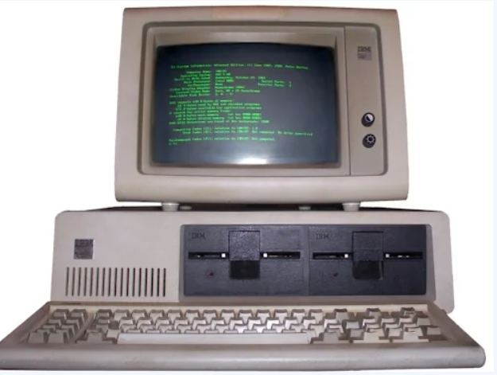
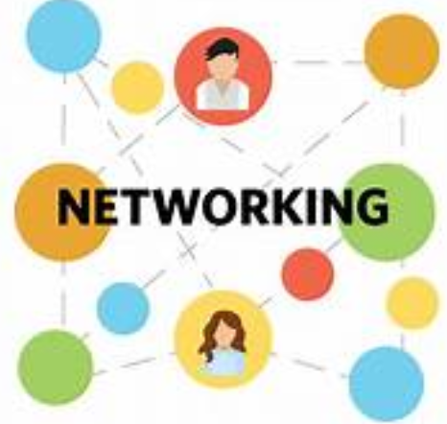
Personal Computer & Networking
Proliferation of PCs in the 1980s and early 1990s launched a spate of personal desktop productivity software tools—word processors, spreadsheets, electronic presentation software, and small data management programs—that were very valuable to both home and corporate users. These PCs were stand-alone systems until PC operating system software in the 1990s made it possible to link them into networks.
Networking is the exchange of information and ideas among people with a common profession or other interest, usually in an informal social setting.

Slide 16
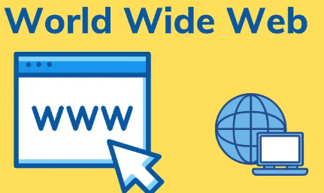
Web
What is WWW?
WWW, which stands for World Wide Web, is a subset of the internet. It is also known as W3 or web. WWW refers to all the web pages or online content that is available on the internet in HTML formatted manner. The web pages and documents available on the internet are connected via hyperlinks. The information available on the web pages can be of various formats consisting of text, image, audio, and video. The WWW or World Wide Web was developed by Tim Berners-Lee at CERN (European library for Nuclear Research) in 1989.

Slide 17
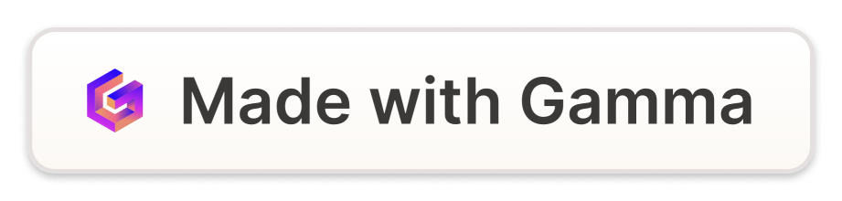
The World Wide Web
World's First Website Goes Online
Netscape's Navigator
Google Smart Search Algorithm
In 1994, Netscape Communications developed the Navigator browser that incorporated graphics and text. The development of the web browser marked a change in the way people experienced the internet.
The first-ever URL was created on December 20, 1990, and brought the world the first website. It only had plain text and basic HTML format weighing in at only 2.7KB.
Launched in 1998, Google's search engine had a straightforward interface, making it work a lot faster than its competitors. It was also the first search engine that used PageRank algorithm.

Slide 18
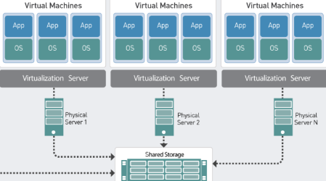
Virtualization
Virtualization enables the hardware resources of a single computer—processors, memory, storage and more—to be divided into multiple virtual computers, called virtual machines (VMs).

Slide 19
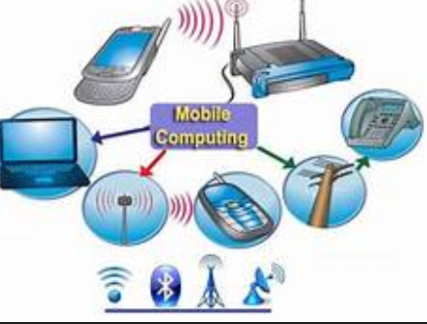
Mobile Computing
Mobile Computing is the technology used for transmitting voice and data through small, portable devices using wireless enabled networks.
Mobile Computing System is a distributed system, which is connected via a wireless network for communication. The clients or the nodes possess mobility and the ability to provide computing at anytime, anywhere.

Slide 20
The Rise of Mobile Technology
1
First Cell Phone Call
In 1973, Motorola researcher Martin Cooper made the first-ever cellular phone call to his rival research head at Bell Labs, Joel Engel.
2
Introduction of iPhone
On June 29, 2007, Steve Jobs unveiled the first iPhone, altering the way people access the internet, take photos, and make phone calls.
3
Mobile Payments
Launched in 2011 as Google Wallet, mobile payments have transformed the payment industry by allowing people to make payments with a mobile app and avoid carrying cash and cards.
4
Virtual Assistants
Virtual assistants like Siri, Alexa, and Google Assistant emerged in 2011 and quickly gained popularity. They have revolutionized the way people interact with their technology devices.

Slide 21
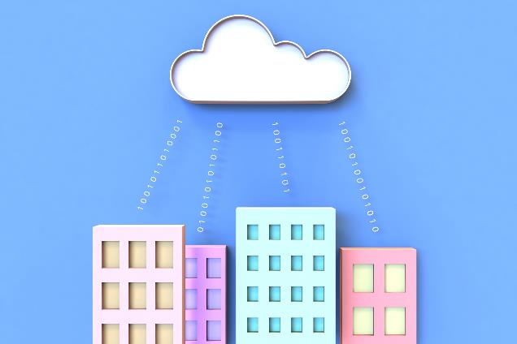
Cloud Computing
Cloud computing is the on-demand delivery of compute power, database, storage, applications, and other IT resources via the internet with pay-as-you-go pricing.
© 2019 Amazon Web Services, Inc. or its Affiliates. All rights reserved.

Slide 22
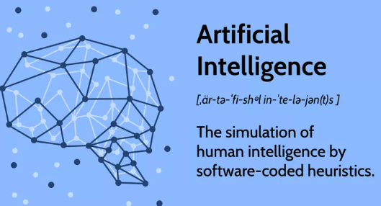
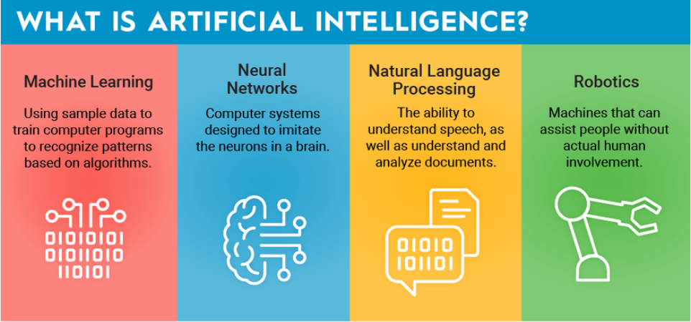
Artificial Intelligence
Artificial intelligence is the simulation of human intelligence processes by machines, especially computer systems.

Slide 23
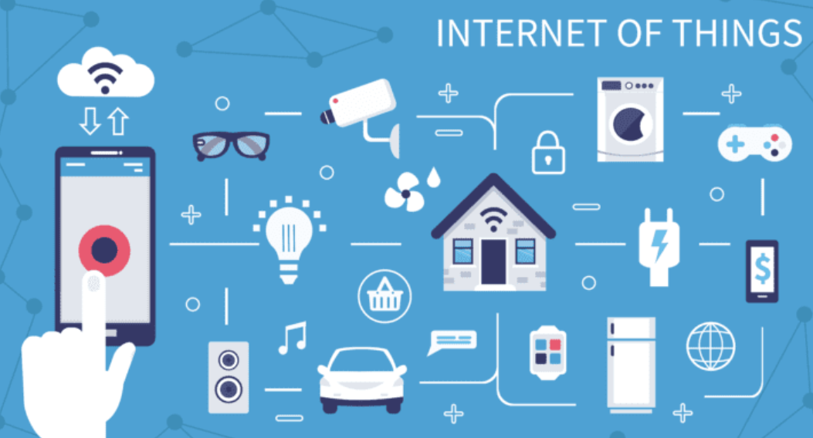
Internet of Things (IoT)
The Internet of Things (IoT) primarily refers to any device, appliance, instrument, or machine that can connect to the internet. They contain sensors, software, and other technologies used to link and exchange data between systems and devices over the Internet.

Slide 24
Internet of Things (IoT)
The Internet of Things (IoT) is a network of interconnected devices that are embedded with sensors, software, and other technologies that enable them to exchange data and interact with other devices and systems.
1
Smart Homes
IoT enabled devices are transforming homes into intelligent and connected spaces by allowing devices to communicate and exchange data.
Smart Cities
2
The use of IoT in urban planning is enabling cities to become smarter and more efficient by optimizing traffic flow, reducing energy consumption, and improving public services.
3
Industry 4.0
The use of IoT in manufacturing is creating a new era of automation and optimization through predictive maintenance, real-time optimization, and reduced downtime.

Slide 25
Edge Computing
A decentralized computing infrastructure that brings compute resources closer to the end-user. This technology reduces latency and increases computation efficiency.

Slide 26
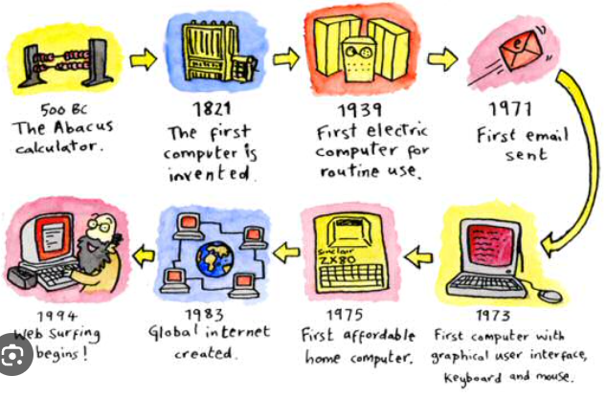
Historical Timeline
Activity
Activity Historical Timeline (15 minutes):
Display a chronological timeline on a whiteboard, screen, or distribute printed handouts that illustrate key milestones in the history of information technology.
Briefly explain each milestone, highlighting its significance:
Early computing machines (e.g., Charles Babbage's Analytical Engine)
Invention of the first electronic computer (e.g., ENIAC)
Development of the internet and the World Wide Web
Emergence of personal computers and smartphones
Open the floor for questions and encourage students to express their curiosity about any of the milestones.

Slide 27
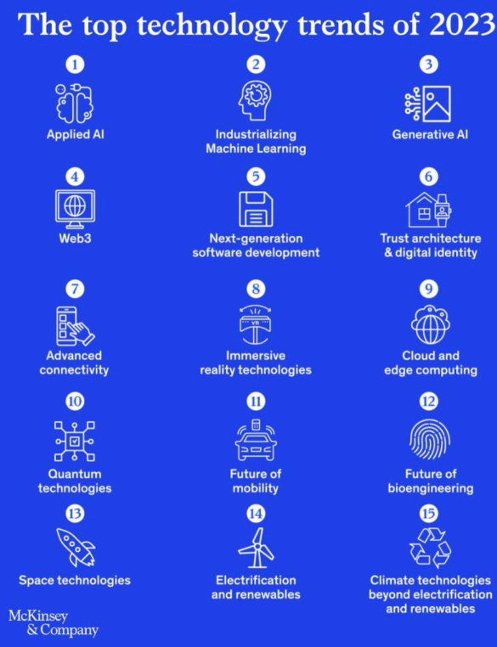
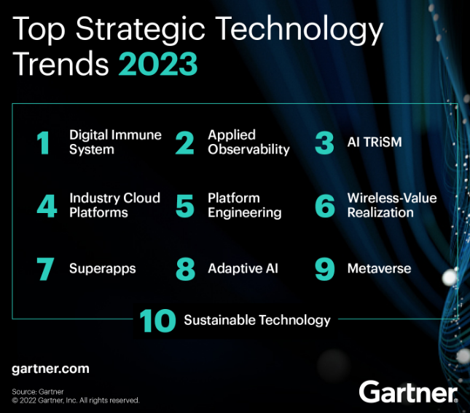

Slide 28
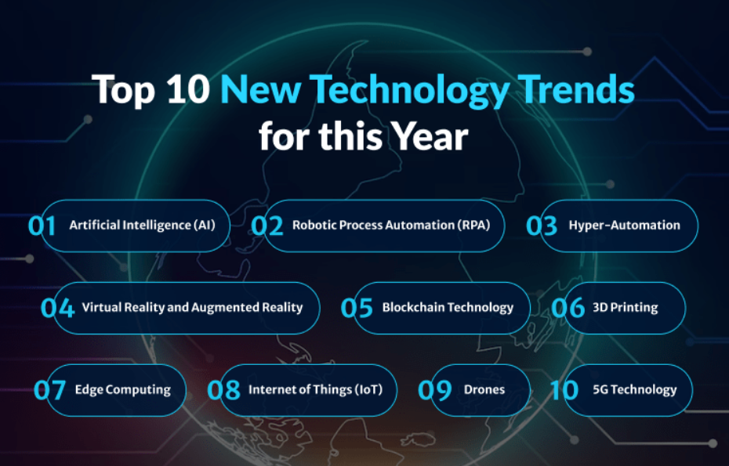
https://www.founderjar.com/new-technology-trends/

Slide 29
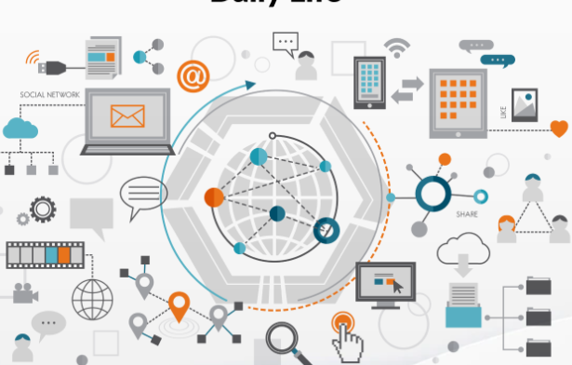
Technology in Everyday Life
Activity
Activity Technology in Everyday Life (15 minutes):
Conduct a whole-class discussion to explore the pervasive role of IT in various aspects of daily life:
Communication (e.g., email, social media, video calls)
Education (e-learning, online research, digital textbooks)
Healthcare (telemedicine, electronic health records)
Entertainment (streaming services, gaming)
Students to share and present their own experiences and anecdotes related to these areas.

Slide 30
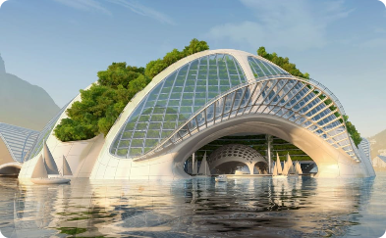
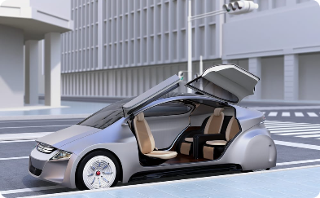
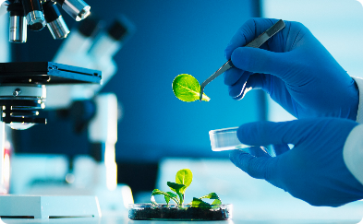
Implications for the Future
As emerging technologies continue to evolve and transform industries, the future holds many possibilities.
Architecture and Construction
Transportation
Healthcare
The use of autonomous vehicles, smart traffic management systems, and hyperloop technology is transforming transportation systems and reducing congestion while improving safety and efficiency.
The use of personalized medicine, gene editing, and bioengineering technologies is accelerating treatments for chronic and genetic diseases and transforming the healthcare industry.
The use of emerging technologies such as AR, VR, and AI in architecture and construction is revolutionizing how buildings are designed, constructed and maintained.

Slide 31
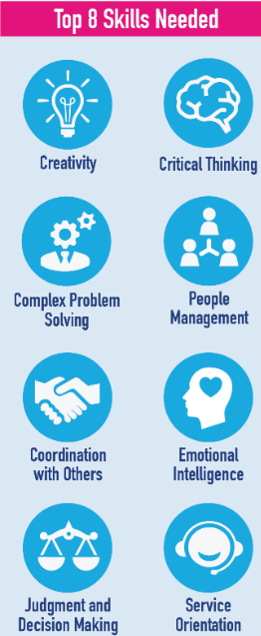
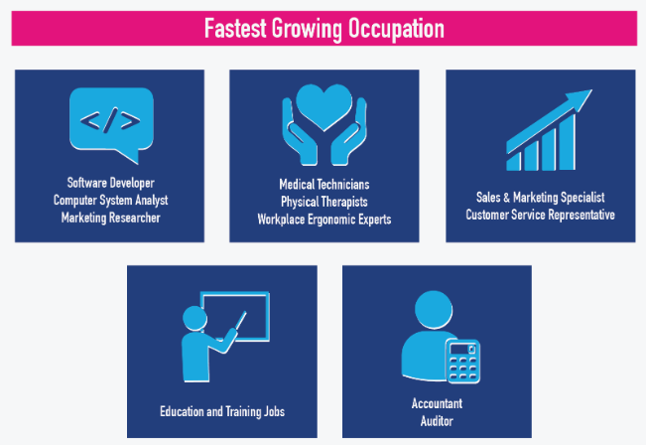
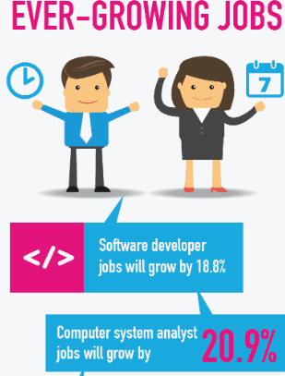
Jobs in 2025
https://www.jobstreet.com.sg/career-advice/article/jobs-2025-expect-survive

Slide 32
Questions
What is information technology (IT)?
Describe the different types of computer trends.
What is emerging technology in IT?
Notes:
Have students turn to the end of Chapter 1 in their textbooks to view the same “Open-Ended” questions/statements

Slide 33

THANK YOU
In the Name of God for Mankind
univteknologimalaysia
utm.my
utmofficial

